Slide 1
Numpy Array and its functions

Slide 2
The Basics of NumPy Arrays
This section will present several examples of using NumPy array manipulation to access data and subarrays, and to split, reshape, and join the arrays.

Slide 3
Array Manipulations
Attributes of arrays: Determining the size, shape, memory consumption, and data types of arrays
Indexing of arrays: Getting and setting the value of individual array elements
Slicing of arrays: Getting and setting smaller subarrays within a larger array
Reshaping of arrays: Changing the shape of a given array
Joining and splitting of arrays: Combining multiple arrays into one, and splitting one array into many

Slide 4
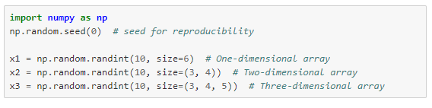
NumPy Array Attributes
Lets start form..
Random arrays
A one-dimensional array
A two-dimensional array
And three-dimensional array

Slide 5
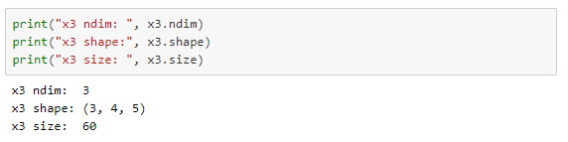
Cont..
Each array has attributes ndim (the number of dimensions), shape (the size of each dimension), and size (the total size of the array):

Slide 6

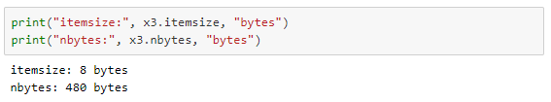
Data type and size of array

Slide 7
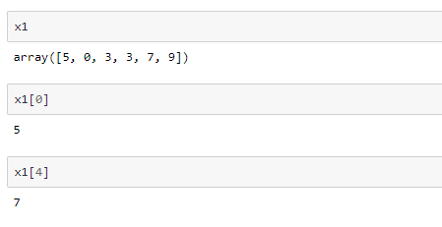
Array Indexing
Accessing Single Elements

Slide 8
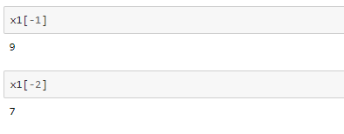
Cont..
For negative indices

Slide 9
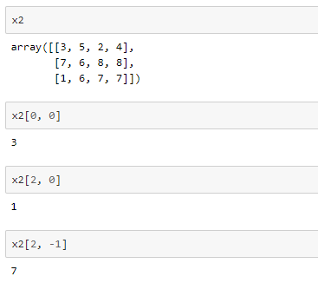
Cont..
In a multi-dimensional array

Slide 10
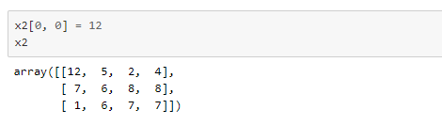

Modifying the values

Slide 11
Array Slicing
Just as we can use square brackets to access individual array elements, we can also use them to access subarrays with the slice notation, marked by the colon (:) character.
The NumPy slicing syntax follows that of the standard Python list; to access a slice of an array x, use this:
x[start:stop:step]
If any of these are unspecified, they default to the values start=0, stop=size of dimension, step=1.

Slide 12
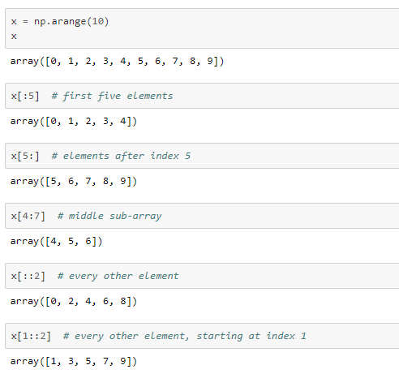
Accessing sub-arrays in one dimension and in multiple dimensions

Slide 13
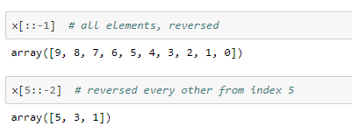
Cont..
A potentially confusing case is when the step value is negative.
In this case, the defaults for start and stop are swapped. This becomes a convenient way to reverse an array:

Slide 14
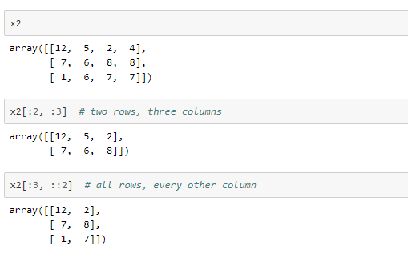
Multi-dimensional subarrays
Multi-dimensional slices work in the same way, with multiple slices separated by commas. For example:

Slide 15
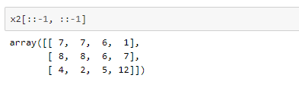
Cont..
Finally, subarray dimensions can even be reversed together:

Slide 16
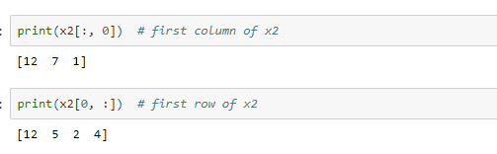
Accessing array rows and columns
One commonly needed routine is accessing of single rows or columns of an array.
This can be done by combining indexing and slicing, using an empty slice marked by a single colon (:):

Slide 17
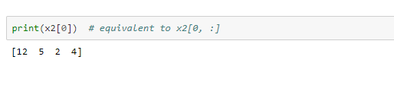
Cont..
In the case of row access, the empty slice can be omitted for a more compact syntax:

Slide 18
Subarrays as no-copy views
One important–and extremely useful–thing to know about array slices is that they return views rather than copies of the array data.
This is one area in which NumPy array slicing differs from Python list slicing: in lists, slices will be copies.

Slide 19
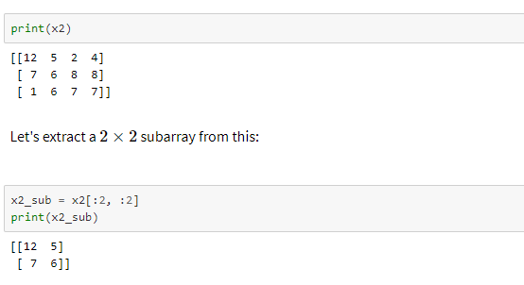
Cont..
Consider our two-dimensional array from before:

Slide 20
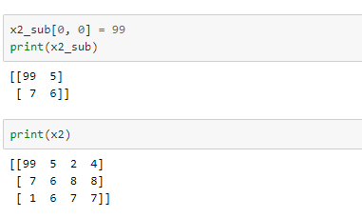
Cont..
Now if we modify this subarray, we'll see that the original array is changed! Observe:

Slide 21
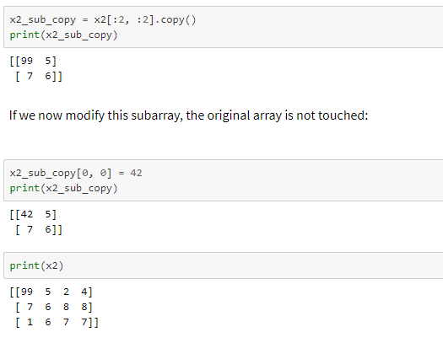
Creating copies of arrays

Slide 22
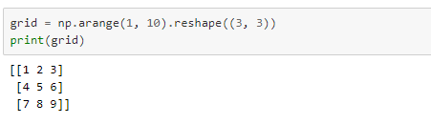
Reshaping of Arrays
Another useful type of operation is reshaping of arrays. The most flexible way of doing this is with the reshape method.
For example, if you want to put the numbers 1 through 9 in a 3×33×3 grid, you can do the following:

Slide 23
Cont..
Another common reshaping pattern is the conversion of a one-dimensional array into a two-dimensional row or column matrix.
This can be done with the reshape method, or more easily done by making use of the newaxis keyword within a slice operation

Slide 24
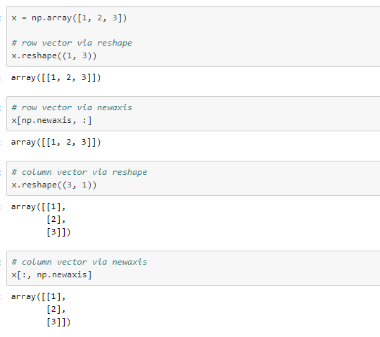
Cont..

Slide 25
Array Concatenation and Splitting
Concatenation, or joining of two arrays in NumPy, is primarily accomplished using the routines np.concatenate, np.vstack, and np.hstack. np.concatenate takes a tuple or list of arrays as its first argument.

Slide 26
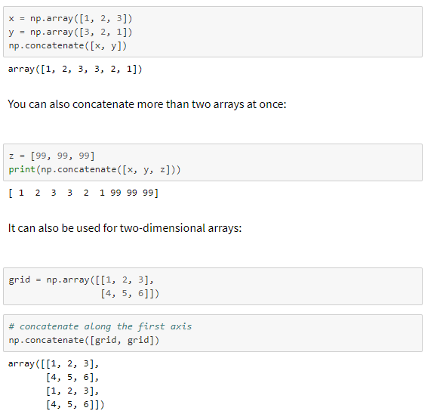

Slide 27
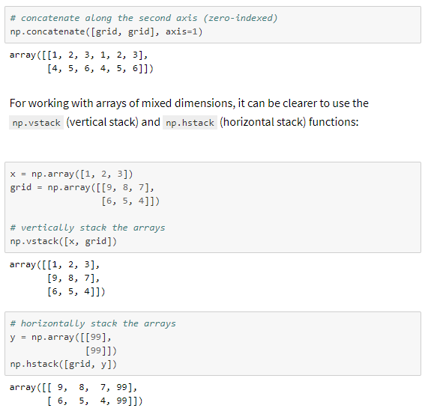

Slide 28
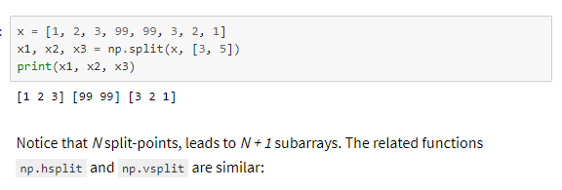
Splitting of arrays
The opposite of concatenation is splitting, which is implemented by the functions np.split, np.hsplit, and np.vsplit.

Slide 29
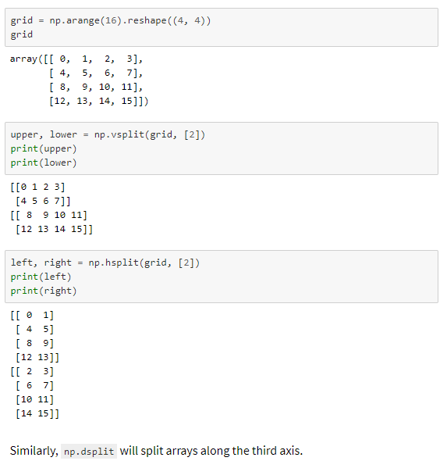

Slide 30
Very Thanks to… https://jakevdp.github.io/
Links:
https://jakevdp.github.io/PythonDataScienceHandbook/02.02-the-basics-of-numpy-arrays.html#Reshaping-of-Arrays
This is an excerpt from the Python Data Science Handbook by Jake VanderPlas; Jupyter notebooks are available on GitHub.

